Slide 1
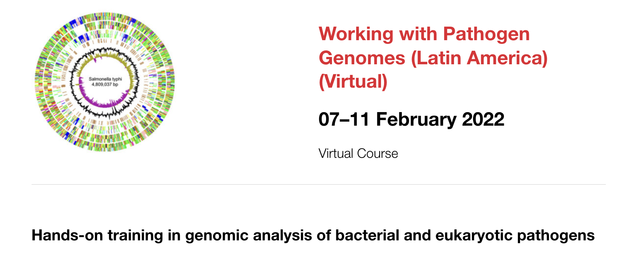


Stephen Doyle
Latin America
2nd February 2022

Slide 2
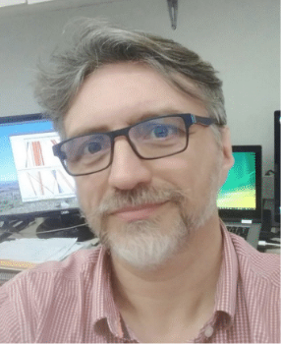
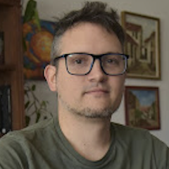
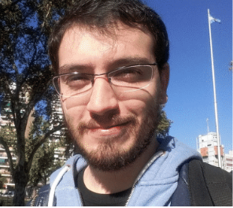
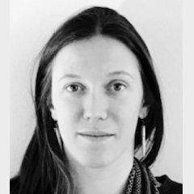
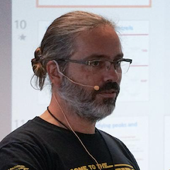
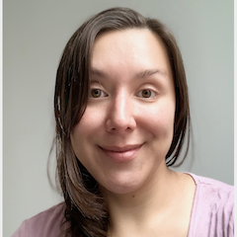
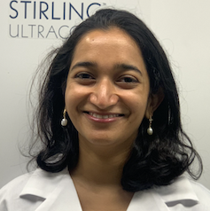
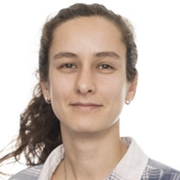
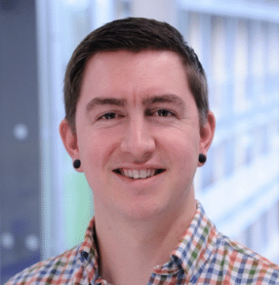
Who we are
Jose (Pepe)
Tort
Rodrigo Quiroga
Steve
Doyle
Lionel Uran Landaburo
Sophie
Belman
Fernan
Aguero
Marcela Suarez Esquivel
Florencia
Díaz Viraqué
Sushmita Sridhar
Daryl
Domman

Slide 3
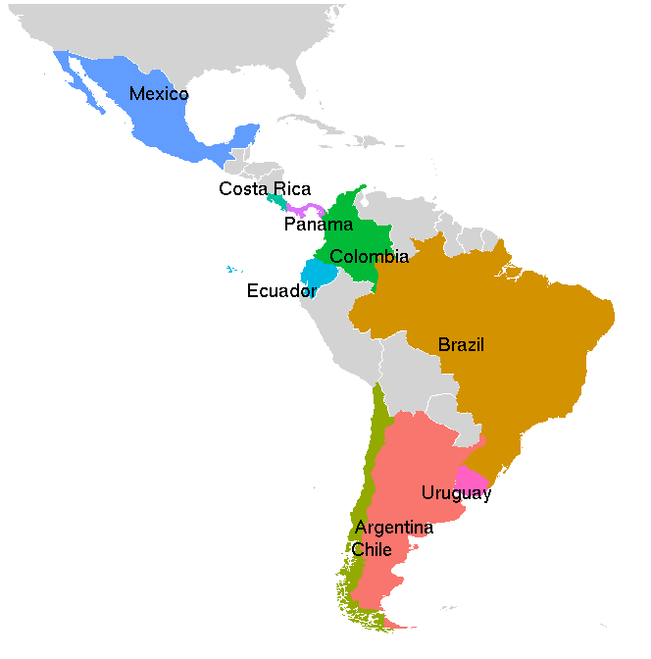
Who you are
27 participants from 9 countries
Working on a variety of prokaryotic and eukaryotic species
Like have or are about to get some genomics data

Slide 4
What do we hope to achieve together?
To provide a broad overview of bioinformatic tools and techniques used for the analysis of pathogen genomes
Some theory, but mostly hands on training
Build confidence in applying these concepts and approaches to your own datasets
Form networks and help each other!

Slide 5
Agenda for the week ahead
Monday | Tuesday | Wednesday | Thursday | Friday
Genome visualization using Artemis | Linux & basic scripting | Phylogenetics | Transcriptomics | Task 2: Bacterial Exercise
Comparative genomics | Short read mapping | Genome assembly | Task 1: Eukaryotic exercise | Presentations & wrap up

Slide 6
Agenda for the week ahead
Seminars:
Yesid Cuesta
Josefina Campos
Luisa Berna
Course materials:
Github: https://wcscourses.github.io/WWPG_2022/
Closed web
DataCamp
Instructor/assistants communication
Slack

Slide 7
Any questions?

Slide 8
Let’s get to know one another!

